Slide 1
Teaching Demo CISC 230 – Data Structures Queues
Michael Hoefer
PhD Candidate
University of Colorado Boulder

Slide 2
Course Overview
Object Oriented Data Structures Course
14 weeks
Topics covered:
Abstract data types (ADT)
Specific data structures: Linked lists, stacks, queues, maps, trees
Implementation options (e.g.: array vs. linked list)
Time complexity for operations
Use cases for each structure
Introduction to algorithms
E.g., breadth-first, depth-first, Dijkstra’s algorithm
Software engineering
Dynamic vs. static memory management
Larger software project

Slide 3
Grading Breakdown
40%: In person, paper exams (2 midterms + 1 final)
20%: final project (code submission + grading interview)
20%: Lab activities/assignments
Quizzes, weekly exercises
10%: Weekly assignments
Implementing data structures
All must be completed to pass the course
10%: Short essay reflections
Explain use cases for different data structures, for example

Slide 4
Course Schedule
Week | Topic
1 | Abstract Data Types, Review of static arrays
2 | Dynamic memory management and dynamic arrays
3 | Singly and doubly linked lists
4 | Introduction to complexity analysis with linked lists
5 | Review and midterm 1
6 | Stacks and queues
7 | Maps
8 | Intro to trees
9 | Trees, cont.
Week | Topic
10 | Review and midterm 2
11 | Priority queues
12 | Graphs and graph algorithms
13 | Graphs and graph algorithms, cont.
14 | Project presentations and final review

Slide 5
Pedagogy Overview
Focus on active learning - learning by doing
In-class
Formation of mental models
Coding observation and imitation (follow along with live coding)
Warm up activities individually or in pairs
Out-of-class
Individual assignments to apply mental models
Assignments build incrementally

Slide 6
Queues

Slide 7
Plan for the day
Warm up activity
Introduce queues
Real world uses
Abstract data type (ADT)
Implementation options
Implement queue
Linked list

Slide 8


Waiting for service
Notes:
Asking about differences, what are the qualities or principles that govern this line

Slide 9
Queues
Used when order matters
First-in, first-out (FIFO)
Notes:
Asking about trying to take this real world situation and create a digital representation. What can we do with this queue? What are the operations?

Slide 10



Queues
Enqueue operation
Dequeue operation
Notes:
Asking about differences, what are the qualities or principles that govern this line

Slide 11
Queues
Enqueue operation
Dequeue operation
Notes:
Asking about differences, what are the qualities or principles that govern this line

Slide 12

Queues
Move everyone forward?
Notes:
Asking about differences, what are the qualities or principles that govern this line

Slide 13
Queues
Move cashier?
Notes:
Asking about differences, what are the qualities or principles that govern this line

Slide 14

Queues
Peek
Notes:
Asking about trying to take this real world situation and create a digital representation. What can we do with this queue? What are the operations?

Slide 15
Queues
Size
8 people
Notes:
Asking about trying to take this real world situation and create a digital representation. What can we do with this queue? What are the operations?

Slide 16
Queues
isEmpty?
true...
Notes:
Asking about trying to take this real world situation and create a digital representation. What can we do with this queue? What are the operations?

Slide 17
Queue Abstract Data Type
Enqueue – new element added to end of queue
Dequeue – first element removed from queue
Peek – first element “looked at” without removal
Size – return number of elements in queue
isEmpty – return true if no elements in queue, false otherwise

Slide 18
Why do we need queues in software?
Processing events where order matters
Operating systems – manage processes and assign tasks
Cloud computing and web servers – handle requests via queues
High frequency trading – buy and sell orders processes in queue
Simulating real world systems – discrete event simulation

Slide 19
Implementing a Queue
How could we implement a queue?

Slide 20
Visualization
https://visualgo.net/en/list

Slide 21
Live Coding

Slide 22
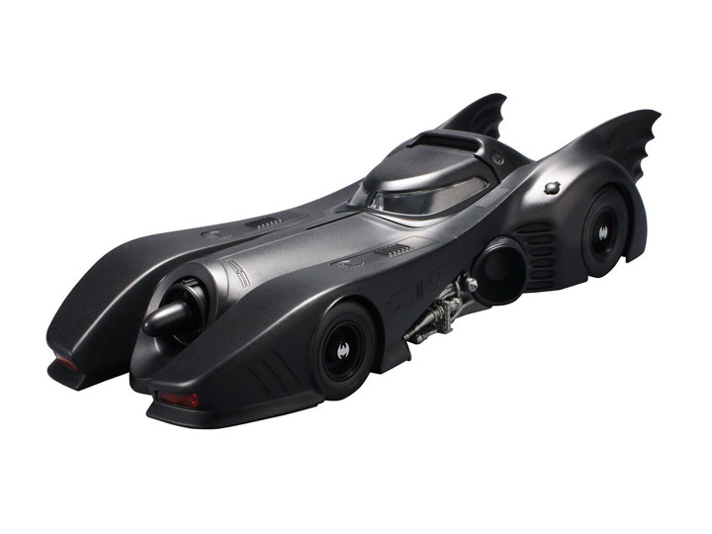


To the CodeMobile!
If no C++ IDE set up, can use:
cpp.sh

Slide 23
Next time
Array based queues, circular queues
Discussion on when to use

